Slide 1
Lecture 9: Intro to NLP, NLP ConvNets, word embeddings

Slide 2
Natural language processing: syntax level
POS-tagging

Slide 3

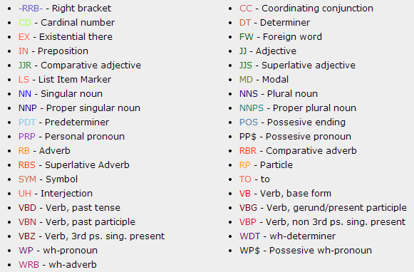
POS tagging
http://cogcomp.cs.illinois.edu/demo/pos/

Slide 4
Natural language processing: syntax level
POS-tagging
Sentence syntax parsing

Slide 5
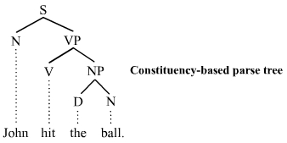
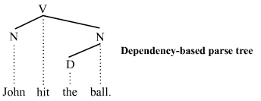
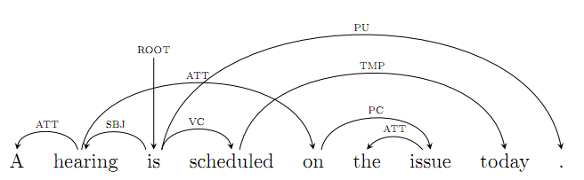
Sentence parsing

Slide 6
Natural language processing: syntax level
POS-tagging
Sentence syntax parsing
Named entity recognition

Slide 7
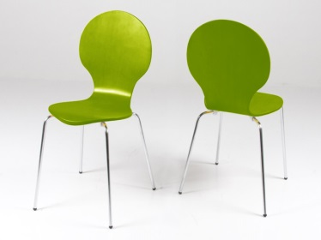
Named entity recognition
Who?
Where?
Mrs. Green spoke today in New York. Green chairs the finance committee…
[example from Koller and Friedman textbook]

Slide 8
Natural language processing: syntax level
POS-tagging
Sentence syntax parsing
Named entity recognition
Coreference resolution
Semantic role labeling (SRL)

Slide 9
Semantic role labeling
He would n’t accept anything of value from those he was writing anout
V: verb A0: acceptor A1: thing accepted A2: accepted-from AM-MOD: modal AM-NEG: negation
Source: CoNLL-2004

Slide 10
Natural language processing: semantic level
Synonyms/paraphrases
Question answering
Chatbots/dialog system
Machine translation
Text summarization
….

Slide 11
Word-based NLP
Baseline approach:
Enumerate words (“lexicon”,”vocabulary”)
Use one-hot encoding
‘dog’
‘cat’
x_{cat}: [0 0 0 0 1 0 0 0 0 ]
x_{kitten}: [0 0 0 0 0 0 1 0 0 ]
x_{teapot}: [0 1 0 0 0 0 0 0 0 ]
Problem:
||x_{cat} - x_{kitten}|| = ||x_{cat} - x_{teapot}||
Solution: intermediate representations

Slide 12
Word-based NLP
x_{cat}: [0 0 0 0 1 0 0 0 0 ]
x_{kitten}: [0 0 0 0 0 0 1 0 0 ]
x_{teapot}: [0 1 0 0 0 0 0 0 0 ]
‘dog’
‘cat’
Problem: very high dimensionality
Partial remedy 1: lemmatize (“Dogs -> dog”, “I’m” ->”I be”)
Side-effect 1: lemmatization looses information
Partial remedy 2: replace infrequent words with “OOV”
Side-effect 2: infrequent words are often very informative

Slide 13
Character-level NLP
A cat sat on the mat.
70 rows (alphabetic, digits, main punctuation symbols)
symbols

Slide 14
Character-level NLP -- todo
Character-level NLP is good because:
school ≈ School
colour ≈ color
2006 ≈ 2007
||Vyatka - Satka|| < || Vyatka - San-Francisco||

Slide 15
Vision vs Natural Language Processing
Vision based on pixels: low-level (5D vectors), noisy, unary and pairwise statistics already informative
NLP based on words: unary statistics very informative (much higher-level units), very different nature (large discrete codebooks)
NLP based on letters: low-level, need to consider long combinations to catch meaning (pairwise not enough)

Slide 16
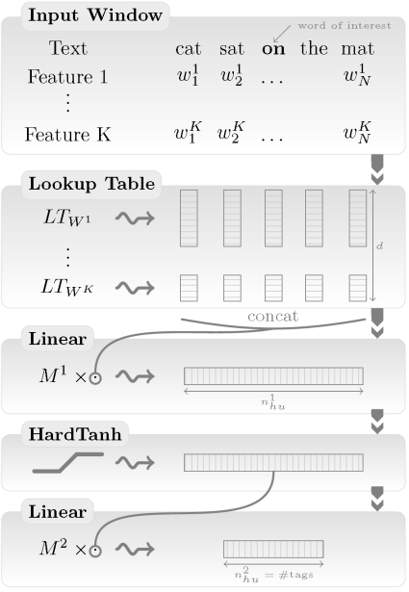
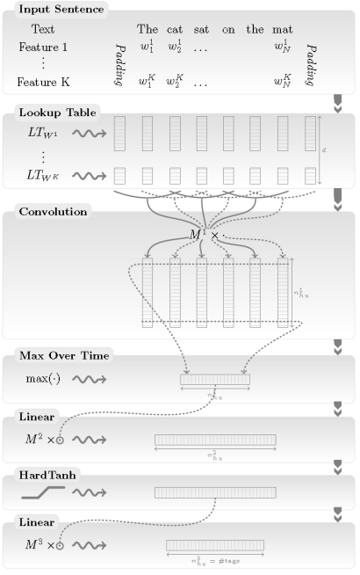
Supervised deep-learning for NLP
word No,
root No,
capitalization, etc.
Variable length
Loss (e.g. softmax)
[Collobert et al. 11]
Loss (e.g. softmax)

Slide 17
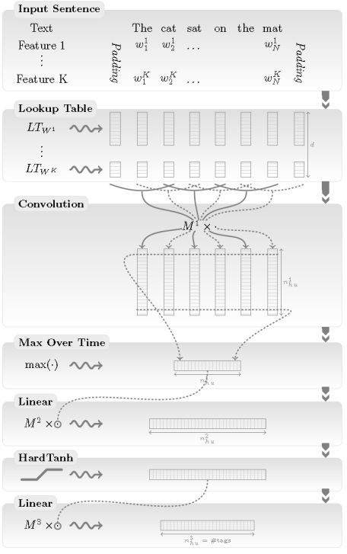
NLP (almost) from scratch: sentence-based
Remark:
ConvNet type architecture (weight-sharing)
For SRL, encode which verb and which word we consider using i-pos_{v} and i-pos_{w} features
[Collobert et al. 11]

Slide 18
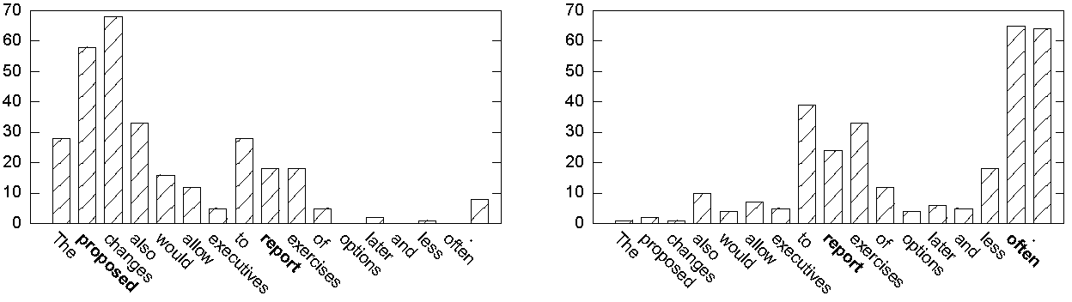
Max-activations
Max-layer produces 300 dim feature
Max-layer is independent across dimensions
How many times a certain word is selected:
w
v
v
w

Slide 19
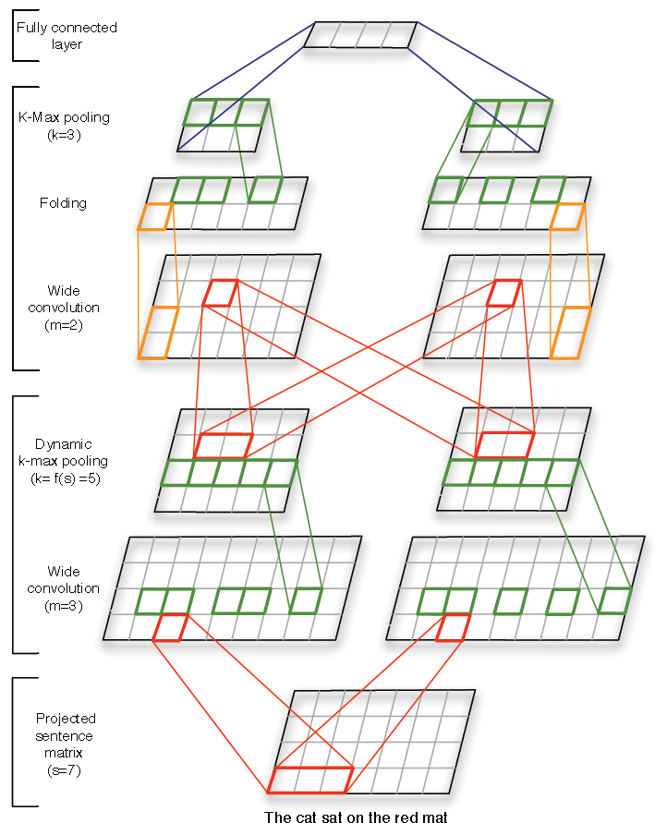
(another) ConvNet for language
Each word encoded with a vector (e.g. “one-hot”)
Filters act along temporal dimension
“Folding” = sum pooling along embedding direction
Key idea: k-max pooling
[Kalchbrenner et al., ACL14]

Slide 20
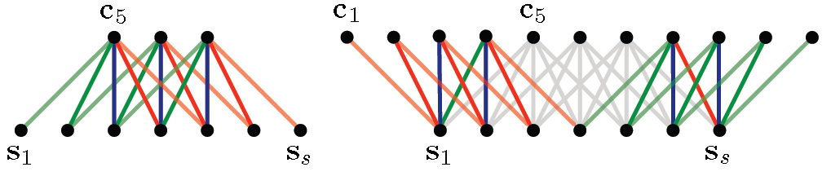
(another) ConvNet for language
Each word encoded with “one-hot” embedding
“Valid” convolution
“Wide” convolution
[Kalchbrenner et al.,. ACL14]

Slide 21
k-max pooling and dynamic k-max pooling
K-max pooling picks k largest elements in each channel
Ordering is kept
Dynamic k-max pooling allocates k to each layer using
[Kalchbrenner et al.,. ACL14]

Slide 22
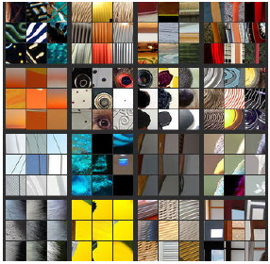
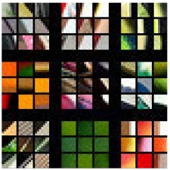
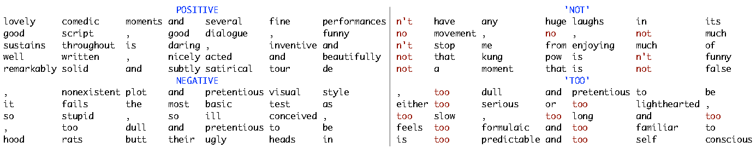
Visualizing filters
Layer 1
[Zeiler Fergus 14]
Layer 2
[Kalchbrenner et al.,ACL14]

Slide 23
Visualizing filters
Layer 1
[Zeiler Fergus 14]
Layer 2
[Kalchbrenner et al.,ACL14]

Slide 24
Character-level ConvNet
Trained for classification end-to-end
All reviews are clipped to 1014 characters
Learned features at the 1st layer
[Zhang et al.15]
Notes:
That thesaurus in turn was obtained fromWord-
Net [7], where every synonym to a word or phrase is ranked by the semantic closeness to the most
frequently seen meaning. To decide on how many words to replace, we extract all replaceable words
from the given text and randomly choose r of them to be replaced. The probability of number r
is determined by a geometric distribution with parameter p in which P[r] pr. The index s of
the synonym chosen given a word is also determined by a another geometric distribution in which
P[s] qs. This way, the probability of a synonym chosen becomes smaller when it moves distant
from the most frequently seen meaning. We will report the results using this new data augmentation
technique with p = 0:5 and q = 0:5.
First layer weights. For each patch, height is the kernel size and width the alphabet size

Slide 25
Character-level ConvNet: evaluation
Sentiment prediction and topic prediction
Data augmentation using synonims thesarus
[Zhang et al.15]

Slide 26
Character-level ConvNet: evaluation
Larger
Word-level CNN
Char-level CNN
[Zhang et al.15]
Notes:
Th = thesaurus augmentation (synonims), Lg/Sm – wide/narrow architectures, Full – with capital letters

Slide 27
Problem with supervised word embeddings
Weak-spot!
Mapping from one-hot vectors to general vectors (aka “embedding layer”)
O(10 mln – 100 mln parameters)
We now have most parameters at the deepest level (bad!)
[Collobert et al. 11]

Slide 28
Predictive learning
Given an element predict nearby elements (e.g. next, previous, adjacent, etc.)
Does not require annotated data (“self-supervised”)
Usually considered as unsupervised, but often works much better than “plain” unsupervised
Particularly prominent in NLP, but now gaining popularity in many fields

Slide 29
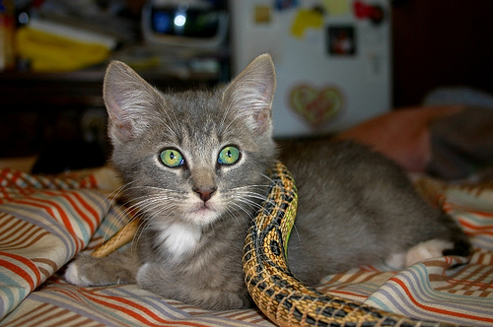
Predictive learning for still images
Classifier
CNN
CNN
[Doersch et al. ICCV15]

Slide 30
















































































































Predictive learning for still images
Input
Ours
Random Initialization
ImageNet AlexNet
[Doersch et al. ICCV15]

Slide 31
Factorization-based word embeddings
the distributional hypothesis : similar context = similar meaning
Co-occurences within certain range (window)
Might want to distinguish left and right co-occurences (m = 2n in this case)
We can remove too “rare” dimensions
co-occurrence matrix
….

Slide 32
Factorization-based word embeddings
One can reduce dimension of the representation:
….
….
SVD allows to get word vectors of e.g. 100 dimensions
Removing negatives, renormalizing and square-rooting helps

Slide 33
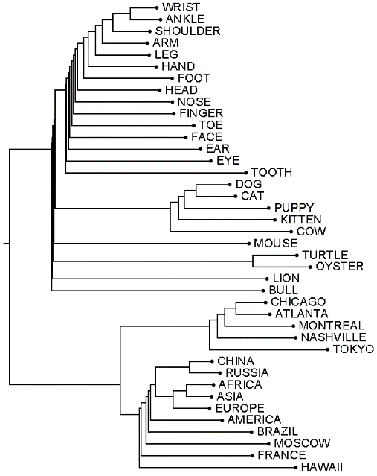
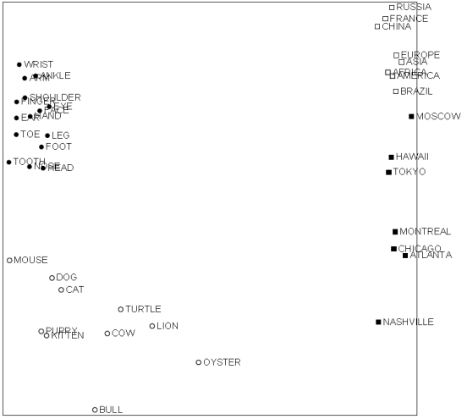
Visualizing word space
MDS visualization:
[Ronde et al. 2006]

Slide 34
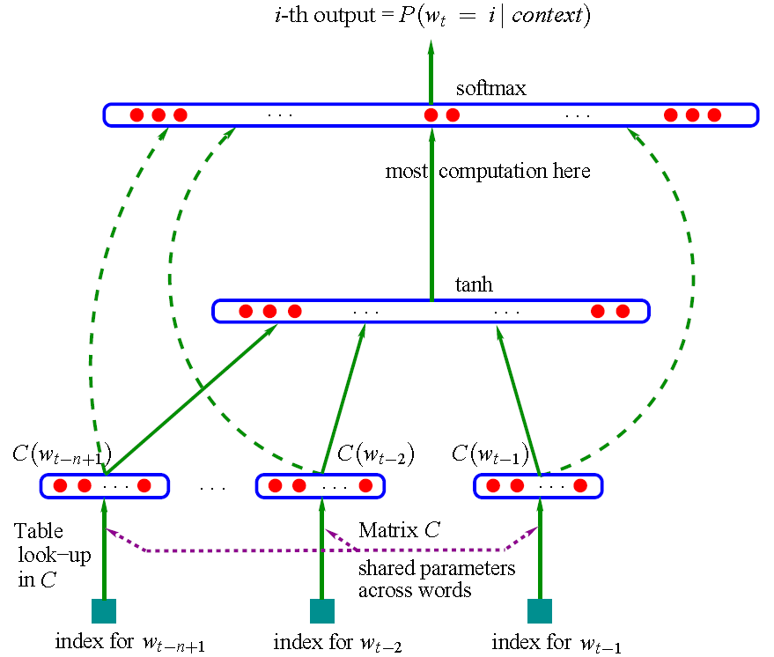
DL for word embeddings
A cat sat on a mat
“mat”
Neural network
embedding layer
“cat”
“sat”
“on”
[Bengio et al. JMLR03]
Notes:
Dashed lines are also multiplicative, solid lines are multiplicative

Slide 35
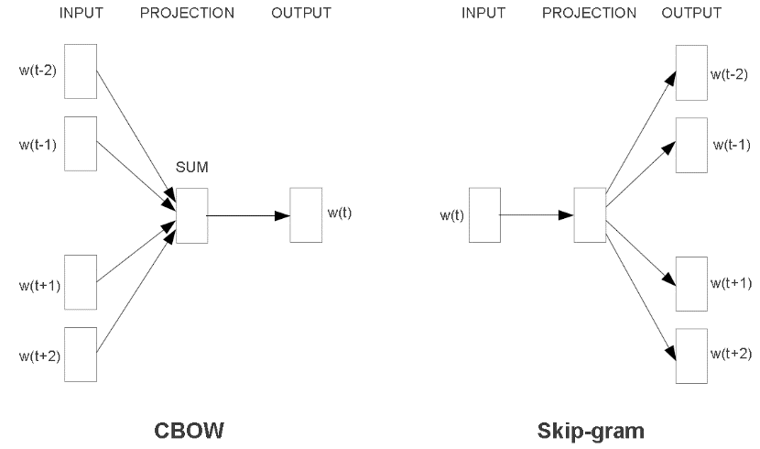
New architectures for word embedding
Both architectures learn an embedding of words into vector space (no hidden layer)
[Mikolov et al. 2013]

Slide 36
Skip-gram model
Each word w is assigned two vectors: v_{w} and v’_{w}
The probability to see the word w_{c} near the word w₀ is then:

Slide 37
Skip-gram model
Computing the probability:
Overall objective (given a center word, predict surrounding ones):
We can now learn embedding on a large corpus

Slide 38
Evaluating the denominator
Impractical!
Idea 1: Hiearchical softmax
Probability of a word = probability of a path
words
[Mnih & Hinton 2009]

Slide 39
Hierarchical softmax
[Mnih & Hinton 2009]
Probability of a word = probability of a path
words
Resulting conditional distribution is normalized!
“Proof”:

Slide 40
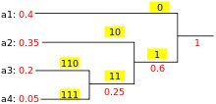
Hierarchical softmax
Probability of a word = probability of a path
words
Tree choice affect quality and speed
Mikolov et al. use Huffman tree (maximizing speed): frequent words have short paths

Slide 41
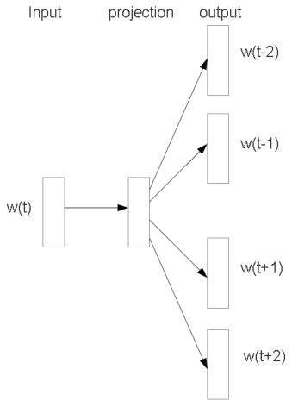
Negative sampling
Idea 2: Negative sampling
Maximizing:
“cat”
“pat”
“SAT”, “bat”
approximating by a few samples (2 – 20)

Slide 42
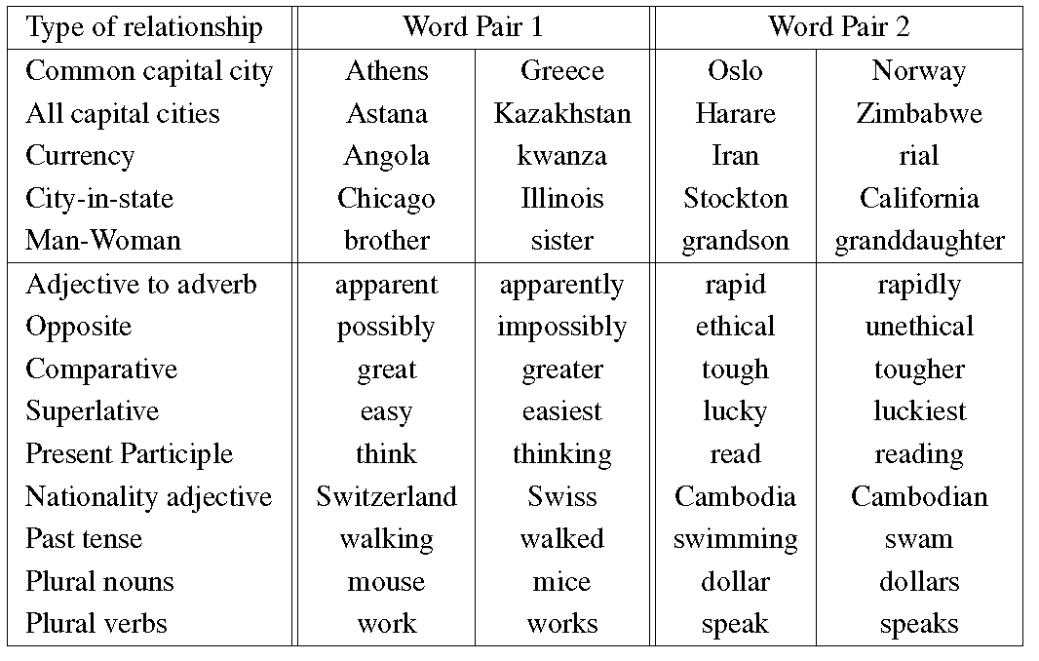
Evaluating using analogies
semantic
syntactic

Slide 43
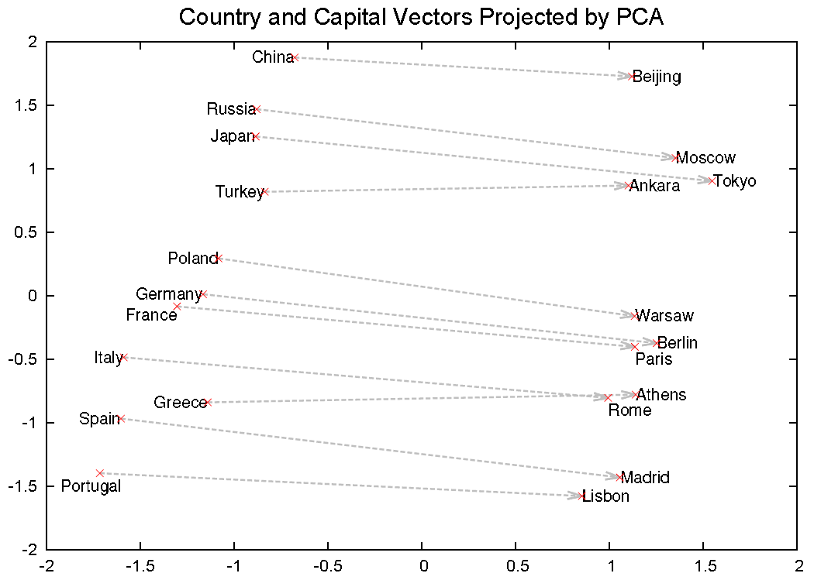
Word2vec analogies
PCA: 1000D->2D
[Mikolov et al. 2013]

Slide 44
Ground truth analogies
[Mikolov et al. 2013]

Slide 45
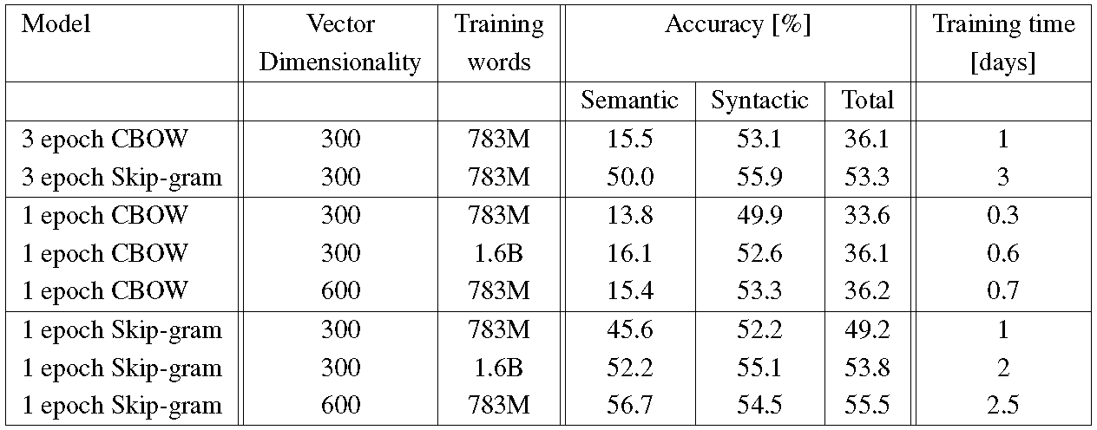
Evaluating using analogies
[Mikolov et al. 2013]
Notes:
To measure quality of the word vectors, we define a comprehensive test set that contains five types of semantic questions, and nine types of syntactic questions. Two examples from each category are shown in Table 1. Overall, there are 8869 semantic and 10675 syntactic questions. The questions in each category were created in two steps: first, a list of similar word pairs was created manually. Then, a large list of questions is formed by connecting two word pairs. For example, we made a list of 68 large American cities and the states they belong to, and formed about 2.5K questions by picking two word pairs at random. We have included in our test set only single token words, thus multi-word entities are not present (such as New York). We evaluate the overall accuracy for all question types, and for each question type separately (semantic, syntactic). Question is assumed to be correctly answered only if the closest word to the vector computed using the above method is exactly the same as the correct word in the question; synonyms are thus counted as mistakes. This also means that reaching 100% accuracy is likely to be impossible, as the current models do not have any input information about word morphology. However, we believe that usefulness of the word vectors for certain applications should be positively correlated with this accuracy metric. Further progress can be achieved by incorporating information about structure of words, especially for the syntactic questions.

Slide 46
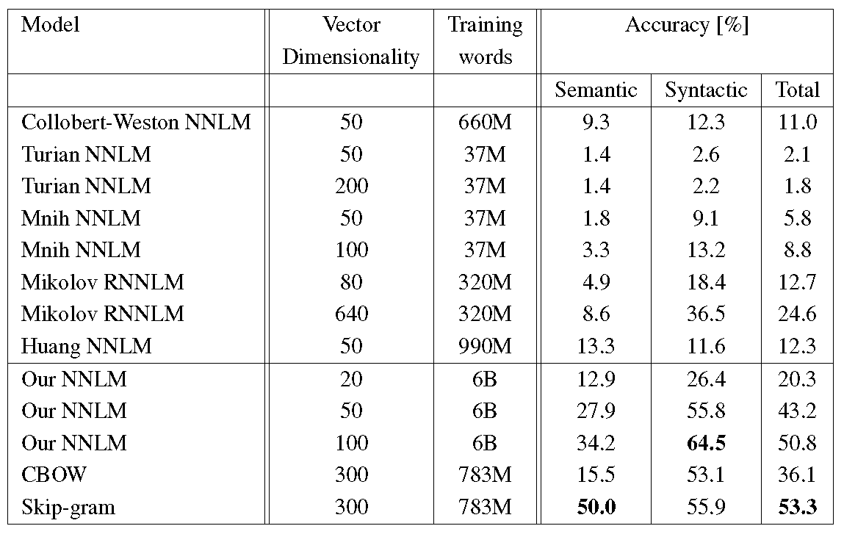
Evaluating using analogies
[Mikolov et al. 2013]

Slide 47
Evaluating using analogies
Trained on 783M words, 300 dim
[Mikolov et al. 2013]

Slide 48
Word2vec reuse
Simple ConvNet initialized with word2vec
[Kim EMNLP14]
Notes:
For all datasets we use: rectified linear units, filter
windows (h) of 3, 4, 5 with 100 feature maps each,
dropout rate (p) of 0.5, l2 constraint (s) of 3, and
mini-batch size of 50. These values were chosen
via a grid search on the SST-2 dev set.

Slide 49
Word2vec reuse
[Kim EMNLP14]
Notes:
• CNN-rand: Our baseline model where all words are randomly initialized and then modified during training. • CNN-static: A model with pre-trained vectors from word2vec. All words— including the unknown ones that are randomly initialized—are kept static and only the other parameters of the model are learned. • CNN-non-static: Same as above but the pretrained vectors are fine-tuned for each task. • CNN-multichannel: A model with two sets of word vectors. Each set of vectors is treated as a ‘channel’ and each filter is applied to both channels, but gradients are backpropagated only through one of the channels. Hence the model is able to fine-tune one set of vectors while keeping the other static. Both channels are initialized with word2vec.
Dataset sizes 3700 -- 12000

Slide 50
Going cross-lingual
[Mikolov et al. 2013]
Notes:
Distributed word vector representations of numbers and animals in English (left) and Spanish (right). The five vectors in each language were projected down to two dimensions using PCA, and then manually rotated to accentuate their similarity. It can be seen that these concepts have similar geometric arrangements in both spaces, suggesting that it is possible to learn an accurate linear mapping from one space to another. This is the key idea behind our method of translation.

Slide 51

Going cross-lingual
$$\min_{W}\sum_{i=1}^{n}{{\left\|Wx_{i}−z_{i}\right\|}^{2}}$$
Train on 5K most frequent
Influence of word2vec training set
[Mikolov et al. 2013]
Notes:
5K most common were used for training
Examples of translations of out-of-dictionary words from Spanish to English. The three most likely translations are shown. The examples were chosen at random from words at ranks 5K–6K. The word representations were trained on the large corpora.

Slide 52
Trans-gram model
Trains from:
Mono-lingual French corpus
Mono-lingual English corpus
Sentence-level aligned parallel corpus
[Coulmance et al. EMNLP15]

Slide 53
Recap
NLP tasks are amenable to deep learning methods
Char-level NLP is promicing
Peculiarity 1: mapping words to vectors (embedding layers)
Peculiarity 2: variable sentence length (more next time)
Lots of success with predictive learning
Today’s lecture: primer (word-level predictive learning), next lectures going to sentences and beyond

Slide 54
Bibliography
Douglas L. T. Rohde, Laura M. Gonnerman, and David C. Plaut. 2006. An improved model of semantic similarity based on lexical co-occurence. Communications of the ACM, 8:627–633.
Yoshua Bengio, Réjean Ducharme, Pascal Vincent, Christian Janvin:
A Neural Probabilistic Language Model. Journal of Machine Learning Research 3: 1137-1155 (2003)
Karlin, Nurit. The Fat Cat Sat on the Mat. New York: HarperCollins, 1996
Tomas Mikolov, Ilya Sutskever, Kai Chen, Gregory S. Corrado, Jeffrey Dean:
Distributed Representations of Words and Phrases and their Compositionality. NIPS 2013: 3111-3119
Carl Doersch, Abhinav Gupta, Alexei A. Efros:
Unsupervised Visual Representation Learning by Context Prediction. ICCV 2015: 1422-1430

Slide 55
Bibliography
Tomas Mikolov, Kai Chen, Greg Corrado, Jeffrey Dean:
Efficient Estimation of Word Representations in Vector Space. CoRR abs/1301.3781 (2013)
Mnih, A. and Hinton, G.~E. A Scalable Hierarchical Distributed Language Model. NIPS 2009
Ronan Collobert, Jason Weston, Léon Bottou, Michael Karlen, Koray Kavukcuoglu, Pavel P. Kuksa:
Natural Language Processing (Almost) from Scratch. Journal of Machine Learning Research 12: 2493-2537 (2011)
Nal Kalchbrenner, Edward Grefenstette, Phil Blunsom:
A Convolutional Neural Network for Modelling Sentences. ACL (1) 2014: 655-665
Jocelyn Coulmance, Jean-Marc Marty, Guillaume Wenzek, Amine Benhalloum:Trans-gram, Fast Cross-lingual Word-embeddings. EMNLP 2015: 1109-1113

